Slide 1
Lesson 3: Arguments
Topics to be covered.
Valid Arguments in Propositional Logic
Rules of Inference for propositional logic
Using Rules of Inference to Build Arguments
Rules of Inference for Quantified Statements
Combining Rules of Inference for Propositions and Quantified Statements

Slide 2
Consistency
A set of statements is logically consistent if they can all be true at the same time. A set of statements is logically inconsistent if they cannot all be true at the same time.

Slide 3
Example
Example: The following statements are logically inconsistent.
All men have blonde hair.
I am a man.
I have brown hair.
Answer: These three beliefs are logically inconsistent. If the first two statements are true, the third must be false. If the third is true, the first or second must be false. They cannot all be simultaneously true.

Slide 4
Valid Argument
An argument in propositional logic is a sequence of propositions. All proposition except the last in are called premises and the ﬁnal proposition is called the conclusion.
An argument is said to be valid if the truth of all its premises implies that the conclusion is true.
An argument form in propositional logic is a collection of propositions involving propositional variables. An argument form is valid no matter which particular propositions are substituted for the propositional variables in its premises and conclusion, the conclusion is true if the premises are all true.

Slide 5
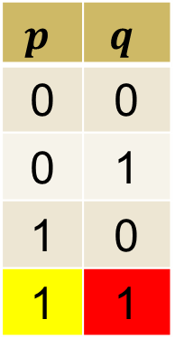
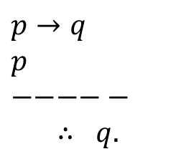
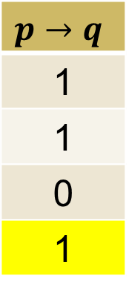
Example
Consider the following argument:
“If you have a current password, then you can log onto the network.”
“You have a current password.”
Therefore,
“You can log onto the network.”
Let p be the proposition “You have a current password.” and let q be “You can log onto the network.”
Then the argument has the form
$$p$$ | $$q$$
0 | 0
0 | 1
1 | 0
1 | 1
$$p→q$$
1
1
0
1
$p→q$
$p$
$−−−−−$
$$∴ q.$$
This is a valid argument

Slide 6
Rules of Inference
Rule of Inference | Name
p p → q ----------- ∴ q | Modus ponens
Rule of Inference | Name
p ---------- ∴ p ∨ q | Addition
¬q p → q ---------- ∴ ¬p | Modus tollens
p ∧ q --------- ∴ p | Simplification
p → q q → r ------------ ∴ p → r | Hypothetical syllogism
p q ---------- ∴ p ∧ q | Conjunction
p ∨ q ¬p ---------- ∴ q | Disjunctive syllogism
p ∨ q ¬ p ∨ r ------------ ∴ q ∨ r | Resolution Prove this is a valid argument?????

Slide 7
How to create a truth table with all possible truth values
p | q | r | p ∨ q | ¬p ∨ r | q ∨ r
T
T
T
T
F
F
F
F

Slide 8
How to create a truth table with all possible truth values
p | q | r | p ∨ q | ¬p ∨ r | q ∨ r
T | T
T | T
T | F
T | F
F | T
F | T
F | F
F | F

Slide 9
How to create a truth table with all possible truth values
p | q | r | p ∨ q | ¬p ∨ r | q ∨ r
T | T | T
T | T | F
T | F | T
T | F | F
F | T | T
F | T | F
F | F | T
F | F | F

Slide 10
How to create a truth table with all possible truth values
p | q | r | p ∨ q | ¬p ∨ r | q ∨ r
T | T | T | T | T | T
T | T | F | T | F | T
T | F | T | T | T | T
T | F | F | T | F | F
F | T | T | T | T | T
F | T | F | T | T | T
F | F | T | F | T | T
F | F | F | F | T | F

Slide 11

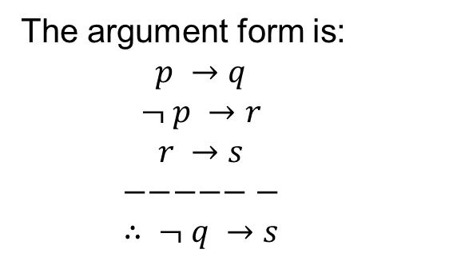
Example of a Valid Argument
Show that the premises “If you send me an e-mail message, then I will ﬁnish writing the program,” “If you do not send me an e-mail message, then I will go to sleep early,” and “If I go to sleep early, then I will wake up feeling refreshed” lead to the conclusion “If I do not ﬁnish writing the program, then I will wake up feeling refreshed.”
Let p – “ You send me an e-mail message”, q – “I will ﬁnish writing the program”,
r – “ I will go to sleep early”, and s - “I will wake up feeling refreshed.”
Step | Reason
1. $p →q$ | Premise
The argument form is:
$$p →q$$
$$¬ p →r$$
$$r →s$$
$$−−−−−−$$
$$∴ ¬ q →s$$
2. $¬ q →¬ p$ | Contrapositive of (1)
3. $¬ p →r$ | Premise
4. $¬ q →r$ | Hypothetical syllogism using (2) and (3)
5. $r →s$ | Premise
6. $¬ q →s$ | Hypothetical syllogism using (4) and (5)

Slide 12
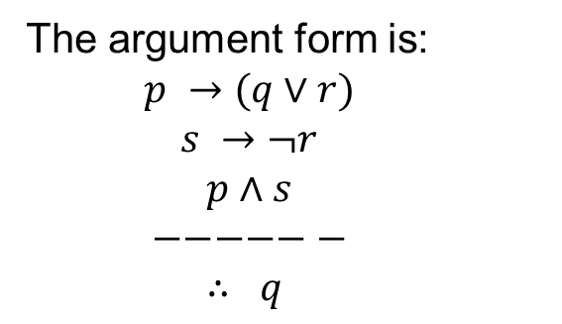
Example
Show that the following argument is valid:
If today is a Friday, then I have a test in CS or a test in Mathematics. If my Mathematics lecturer is sick, then I will not have a test in Mathematics. Today is Friday and my Mathematics lecturer is sick.
Therefore, I have a test in CS.
Let p – “Today is a Friday”, q – “I have a test in CS ”,
r – “ I have a test in Mathematics” s - “My Mathematics lecturer is sick.”
The argument form is:
$$p →(q∨r)$$
$$s →¬r$$
$$p∧s$$
$$−−−−−−$$
$$∴ q$$

Slide 13

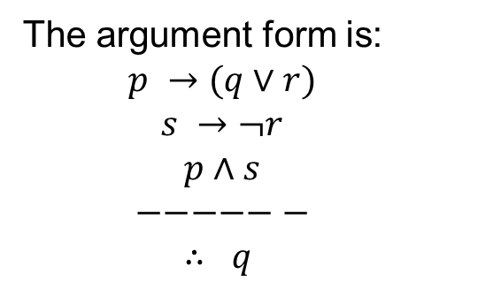
Example Continued
Step | Reason
1. $p∧s$ | Premise
2. $s$ | Simplification from (1)
The argument form is:
$$p →(q∨r)$$
$$s →¬r$$
$$p∧s$$
$$−−−−−−$$
$$∴ q$$
3. $p$ | Simplification from (1)
4. $s →¬r$ | Premise
5. $¬r$ | Modus ponens from (2) & (4)
6.$p →(q∨r)$ | Premise
7. 𝑞 ∨ 𝑟 | Modus ponens from (3) & (6)
8. 𝑞 | Resolution from (5) & (7)
Hence the argument is valid.

Slide 14
Exercise
Show that the following argument is valid:
Gary is intelligent or a good actor.
If Gary is intelligent, then he can count from 1 to 10.
Gary can only count from 1 to 3.
Therefore, Gary is a good actor.

Slide 15
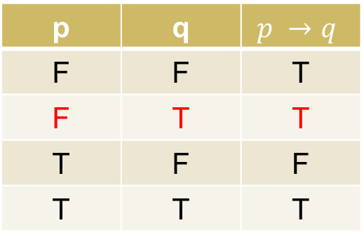
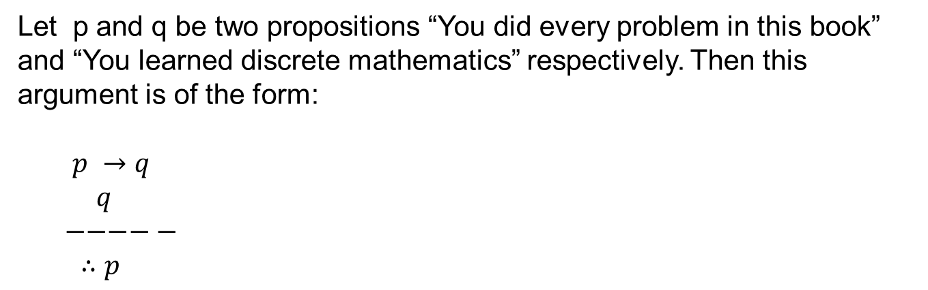
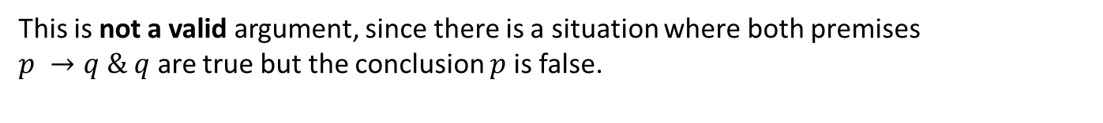
Fallacy of affirming the consequence
Is the following argument valid?
If you do every problem in this book, then you will learn discrete mathematics. You learned discrete mathematics.
Therefore, you did every problem in this book.
Let p and q be two propositions “You did every problem in this book” and “You learned discrete mathematics” respectively. Then this argument is of the form:
$p →q$
$q$
$−−−−−$
$∴p$
p | q | $$p →q$$
F | F | T
F | T | T
T | F | F
T | T | T
This is not a valid argument, since there is a situation where both premises $p →q \& q$ are true but the conclusion $p$ is false.

Slide 16
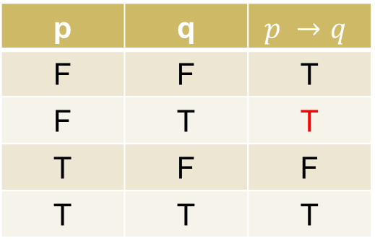

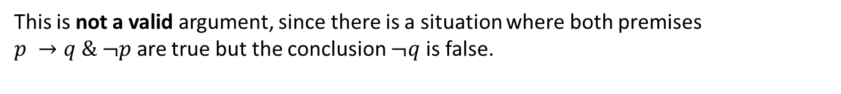
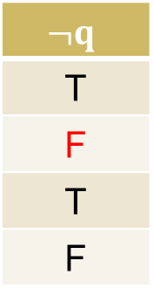
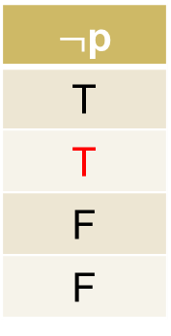
Fallacy of denying the antecedent
The following argument form is not valid
$$p →q$$
$$¬ p$$
$$−−−−−$$
$$∴¬ q$$
p | q | $$p →q$$
F | F | T
F | T | T
T | F | F
T | T | T
$¬$p
T
T
F
F
$$¬q$$
T
F
T
F
This is not a valid argument, since there is a situation where both premises $p →q \& ¬p$ are true but the conclusion $¬q$ is false.

Slide 17
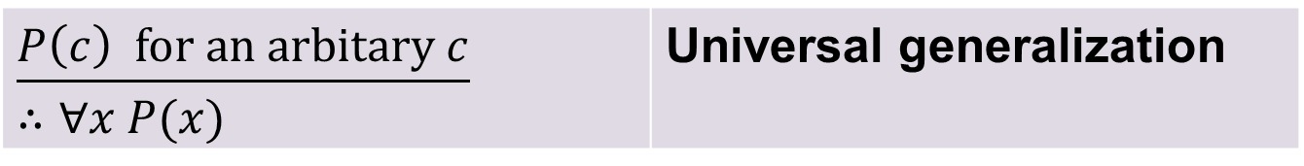
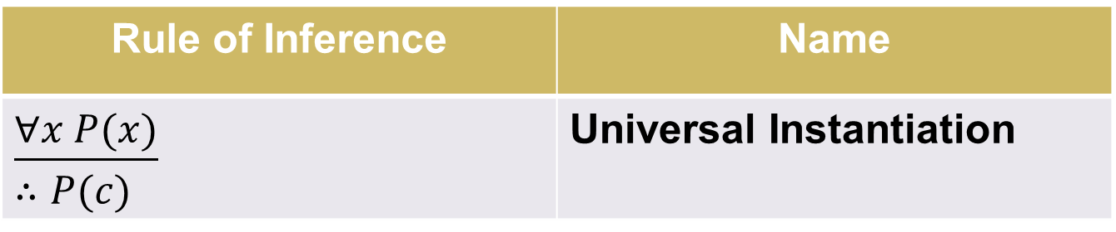
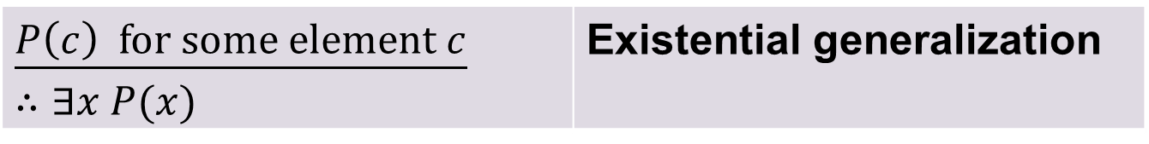
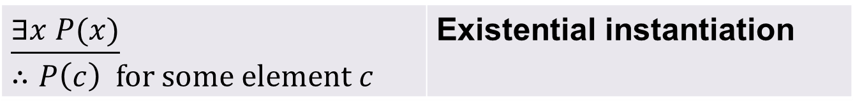
Rules of Inference for Quantiﬁed Statements
Rule of Inference | Name
$$\underline{∀x P(x)}$$ $$∴P(c)$$ | Universal Instantiation
$$\underline{P\left(c\right) for an arbitary c}$$ $$∴∀x P(x)$$ | Universal generalization
$$\underline{∃x P(x)}$$ $$∴P\left(c\right) for some element c$$ | Existential instantiation
$$\underline{P\left(c\right) for some element c}$$ $$∴∃x P(x)$$ | Existential generalization

Slide 18
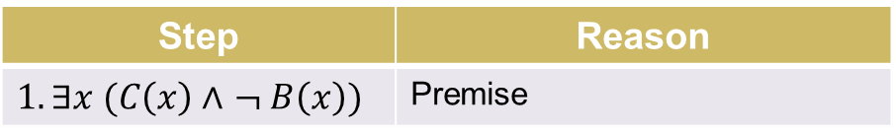
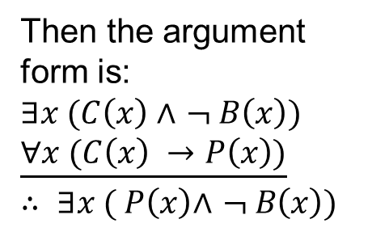
Example
Show that the premises “A student in this class has not read the book,” and “Everyone in this class passed the ﬁrst exam” imply the conclusion “Someone who passed the exam has not read the book.”
Solution:
Let C(x) be “x is in this class,”
B(x) be “x has read the book,” and P(x) be “x passed the ﬁrst exam.”
Step | Reason
$$1.∃x (C\left(x\right) \text{∧} ¬ B\left(x\right))$$ | Premise
$$2. C(a) \text{∧} ¬ B\left(a\right)$$ | Existential instantiation from (1)
$$3. C(a)$$ | Simpliﬁcation from (2)
Then the argument
form is:
$∃x (C\left(x\right) \text{∧} ¬ B\left(x\right))$
$$\underline{∀x (C\left(x\right) →P\left(x\right))}$$
$$∴ ∃x ( P\left(x\right)\text{∧ }¬ B\left(x\right))$$
$$4.∀x (C(x) →P(x))$$ | Premise
$$5.C(a) →P(a)$$ | Universal instantiation from (4)
$$6. P(a)$$ | Modus ponens from (3) and (5)
$$7.¬ B(a)$$ | Simpliﬁcation from (2)
$$8.P\left(a\right) ∧ ¬ B(a)$$ | Conjunction of (6) and (7)
$$9.∃x ( P(x)∧ ¬ B(x))$$ | Existential generalization from (8)

Slide 19
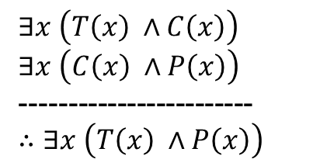
Example
Test the validity of the following argument:
Some trigonometric functions are continuous.
Some continuous functions are periodic.
Therefore, Some trigonometric functions are periodic.
T(x) – x is a trigonometric function
C(x) – x is a continuous function
P(x) – x is a periodic function.
C
T
P
$∃x \left(T\left(x\right) ∧C\left(x\right)\right)$
$∃x \left(C\left(x\right) ∧P\left(x\right)\right)$
------------------------
$∴∃x \left(T\left(x\right) ∧P\left(x\right)\right)$
Under this interpretation conclusion is not true.
Hence, this argument is not valid.

Slide 20
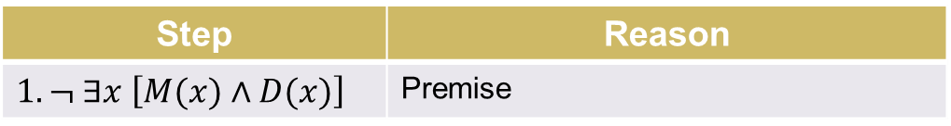
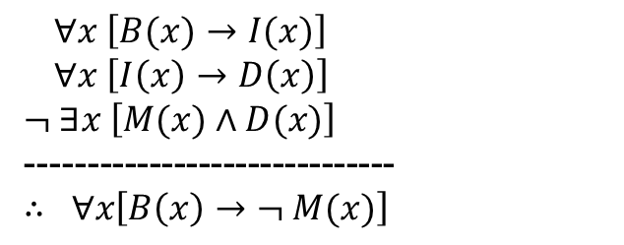
Example Continued
Let $a$ be an arbitrary person from the world (Universe).
Step | Reason
$$1.¬ ∃x \left[M(x)∧D(x)\right]$$ | Premise
$$2. ∀x ¬ \left[D(x)∧M(x)\right]$$ | Equivalent to (1)
$∀x \left[B(x)→I(x)\right]$
$∀x \left[I\left(x\right)→D\left(x\right)\right]$
$¬ ∃x \left[M(x)∧D(x)\right]$
------------------------------
$∴ ∀x\left[B\left(x\right)→¬ M(x)\right]$
$$3. ∀x \left[¬ D\left(x\right)∨¬M(x)\right]$$ | De Morgan’s Law
$$4. ∀x \left[D\left(x\right)→¬M(x)\right]$$ | Equivalent to (1)
$$5. \left[B\left(a\right)→I(a)\right]$$ | Universal Instantiation of 1st Premise
$$6. \left[I\left(a\right)→D(a)\right]$$ | Universal Instantiation of 2nd Premise
$$7. \left[D\left(a\right)→¬ M(a)\right]$$ | Universal Instantiation of (4)
$$8. \left[B\left(a\right)→D(a)\right]$$ | Hypothetical syllogism of (5) and (6)
$$9. \left[B\left(a\right)→¬ M(a)\right]$$ | Hypothetical syllogism of (8) and (7)
$$10.∀x\left[B\left(x\right)→¬ M(x)\right]$$ | Universal generalization of (9).

Slide 21
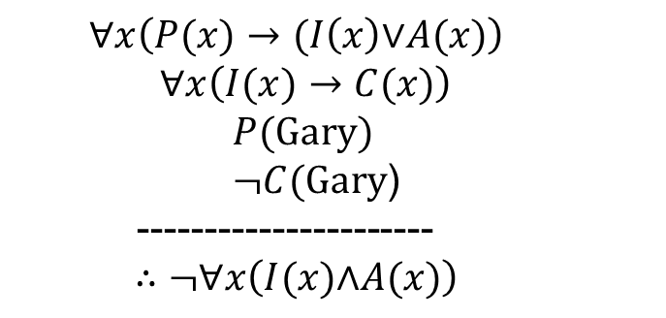
Another Example
Test the validity of the argument:
Anyone performs well is either intelligent or a good actor.
If someone is intelligent, then he/she can count from 1 to 10.
Gary performs well.
Gary can only count from 1 to 3.
Therefore, not everyone is both intelligent and a good actor.
P(x): x performs well
I(x): x is intelligent
A(x): x is a good actor
C(x): x can count from 1 to 10
$$∀x\left(P(x)→(I\left(x\right)\text{∨}A(x)\right)$$
$$∀x\left(I(x)→C(x)\right)$$
$$P(Gary)$$
$¬C(Gary$)
----------------------
$$∴¬∀x\left(I(x)\text{∧}A(x)\right)$$

Slide 22
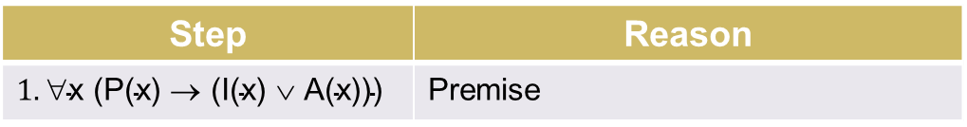
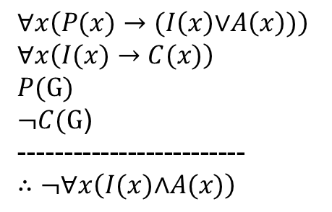
Solution
Step | Reason
$$1.\text{∀}\text{x}\text{ (}\text{P}\text{(}\text{x}\text{) → }\text{(}\text{I}\text{(}\text{x}\text{) ∨ }\text{A}\text{(}\text{x}\text{)}\text{)}\text{)}$$ | Premise
$$2. \text{P}\text{(}\text{G}\text{) → }\text{(}\text{I}\text{(}\text{G}\text{) ∨ }\text{A}\text{(}\text{G}\text{)}\text{)}$$ | Universal instantiation from (1)
$$3. \text{P}\text{(}\text{G}\text{) }$$ | Premise
$$4.\text{I}\text{(}\text{G}\text{) ∨ }\text{A}\text{(}\text{G}\text{)}$$ | Modus ponens from (2) and (3)
$∀x\left(P(x)→(I\left(x\right)\text{∨}A\left(x\right))\right)$
$$∀x\left(I(x)→C(x)\right)$$
$$P(G)$$
$¬C(G$)
-------------------------
$$∴¬∀x\left(I(x)\text{∧}A(x)\right)$$
$$5.\text{∀}\text{x}\text{ (}\text{I}\text{(}\text{x}\text{) → }\text{C}\text{(}\text{x}\text{))}$$ | Premise
$$6.\text{I}\text{(}\text{G}\text{) → }\text{C}\text{(}\text{G}\text{)}$$ | Universal instantiation from (5)
$$7. ¬ C(G\text{)}$$ | Premise
$$8.¬ \text{I}\text{(}\text{G}\text{)}$$ | Modus tollens from (6) and (7)
$$9.\text{¬} \text{I}\text{(}\text{G}\text{) ∨ ¬} \text{A}\text{(}\text{G}\text{)}$$ | Addition from (8)
$$10.\text{¬} \text{(}\text{I}\text{(}\text{G}\text{) ∧ }\text{A}\text{(}\text{G}\text{))}$$ | De Morgan’s Law
$$11.\text{∃}\text{x} \text{¬} \text{(}\text{I}\text{(}\text{x}\text{) ∧ }\text{A}\text{(}\text{x}\text{))}$$ | Existential generalization from (10)
$$12.¬ ∀x \left(I(x) \text{∧} A(x)\right)$$ | Equivalent to (11).

Slide 23
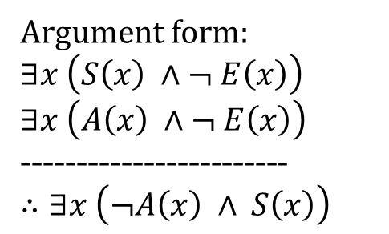
Example
Test the validity of the following argument:
Some Scientists are not Engineers.
Some Astronauts are not Engineers.
Hence, some Scientists are not Astronauts.
Let E(x) – “x is an Engineer”
A(x) – “x is an Astronaut”
S(x) – “x is a Scientist”
S
A
E
Argument form:
$∃x \left(S\left(x\right) ∧¬ E\left(x\right)\right)$
$∃x \left(A\left(x\right) ∧¬ E\left(x\right)\right)$
------------------------
$∴∃x \left(¬A\left(x\right) ∧ S\left(x\right)\right)$
Under this interpretation conclusion is not true.
Hence, this argument is not valid.

Slide 24
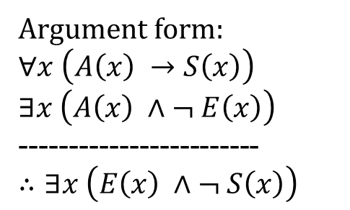
Example
Test the validity of the following argument:
All Astronauts are Scientists.
Some Astronauts are not Engineers.
Hence, some Engineers. are not Scientists.
S
Let E(x) – “x is an Engineer”
A(x) – “x is an Astronaut”
S(x) – “x is a Scientist”
A
E
Argument form:
$∀x \left(A\left(x\right) →S\left(x\right)\right)$
$∃x \left(A\left(x\right) ∧¬ E\left(x\right)\right)$
------------------------
$∴∃x \left(E\left(x\right) ∧¬ S\left(x\right)\right)$
Under this interpretation conclusion is not true.
Hence, this argument is not valid.

Slide 25
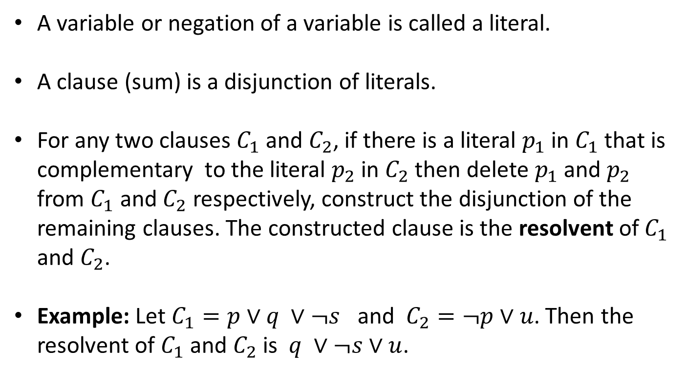
Resolvent
A variable or negation of a variable is called a literal.
A clause (sum) is a disjunction of literals.
For any two clauses $C_{1}$ and $C_{2}$, if there is a literal $p_{1}$ in $C_{1}$ that is complementary to the literal $p_{2}$ in $C_{2}$ then delete $p_{1}$ and $p_{2}$ from $C_{1}$ and $C_{2}$ respectively, construct the disjunction of the remaining clauses. The constructed clause is the resolvent of $C_{1}$ and $C_{2}$.
Example: Let $C_{1}=p∨q ∨¬s$ and $C_{2}=¬p∨u$. Then the resolvent of $C_{1}$ and $C_{2}$ is $q ∨¬s∨u$.

Slide 26
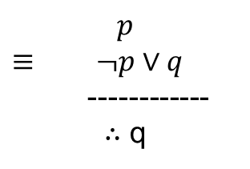
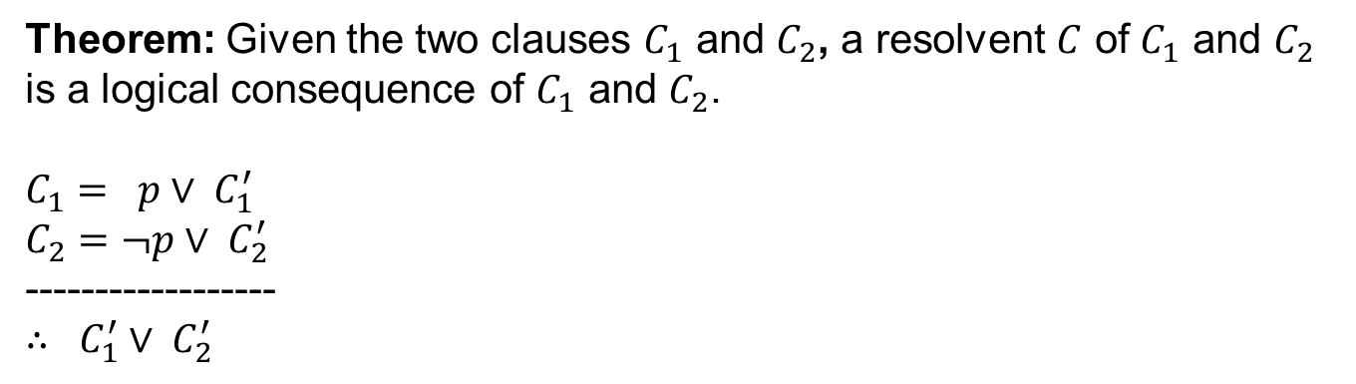
Theorem
Theorem: Given the two clauses $C_{1}$ and $C_{2}$, a resolvent $C$ of $C_{1}$ and $C_{2}$ is a logical consequence of $C_{1}$ and $C_{2}$.
$C_{1}= p∨ C_{1}^{′}$
$C_{2}=¬p∨ C_{2}^{′}$
------------------
$∴ C_{1}^{′}∨ C_{2}^{′}$
Modus Ponens
p
p → q
-----------
∴ q
$$p$$
$≡ ¬p∨q$
------------
∴ q

Slide 27
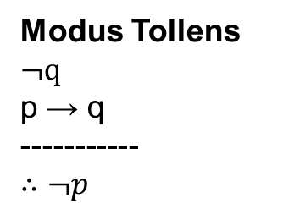
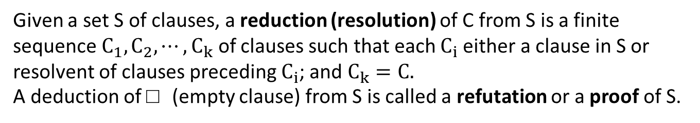
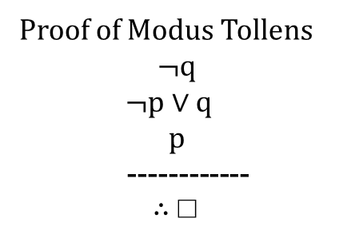
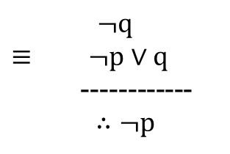
Resolution Principle
Given a set S of clauses, a reduction (resolution) of C from S is a finite sequence $C_{1}, C_{2}, ⋯, C_{k}$ of clauses such that each $C_{i}$either a clause in S or resolvent of clauses preceding $C_{i}$; and $C_{k}=C.$
A deduction of □ (empty clause) from S is called a refutation or a proof of S.
Modus Tollens
$¬q$
p → q
-----------
∴ $¬p$
$$¬q$$
$≡ ¬p∨q$
------------
∴ $¬p$
Proof of Modus Tollens
$$¬q$$
$¬p∨q$
$$p$$
------------
∴ □

Slide 28
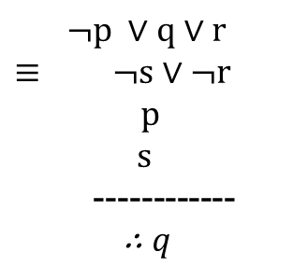

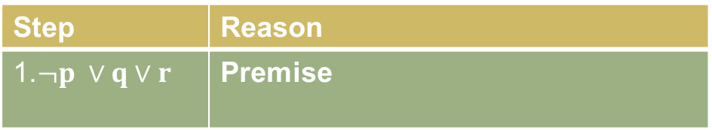
Example (Revisit)
Step | Reason
1.$¬p ∨q∨r$ | Premise
Consider the valid
argument:
$$p →\left(q∨r\right)$$
$$s →¬r$$
$$p∧s$$
$$−−−−−−$$
$$∴ q$$
2. $p$ | Premise
$$¬p ∨q∨r$$
$≡ ¬s∨¬r$
$p$
$s$
------------
∴ $q$
3. $q∨r$ | Resolution from (1) & (2)
4.$¬s∨¬r$ | Premise
5..$¬s∨q$ | Resolution from (3) & (4)
6.$s$ | Premise
7. 𝑞 | Resolution from (5) & (6)
Applications of Resolution Principle:
This is very much used in the logic programing language PROLOG.
It is used in artificial intelligence applications.

